Slide 1

Billboard #1 Singles
Ben Wakefield and Qiaoying Ma

Slide 2

Presentation Overview
Database
Data Domain
Schema
UML Diagram
Application Architecture
User Functionality
Operation Workflow: Create
Operation Workflow: Read
Operation Workflow: Update
Operation Workflow: Delete
Project Relevance
Questions

Slide 3

Database Data Domain
Stores the records of the Billboard Year-End #1 Singles Charts, including the following data for each single:
Chart genre
Release year
A-side song
B-side song
Record label

Slide 4

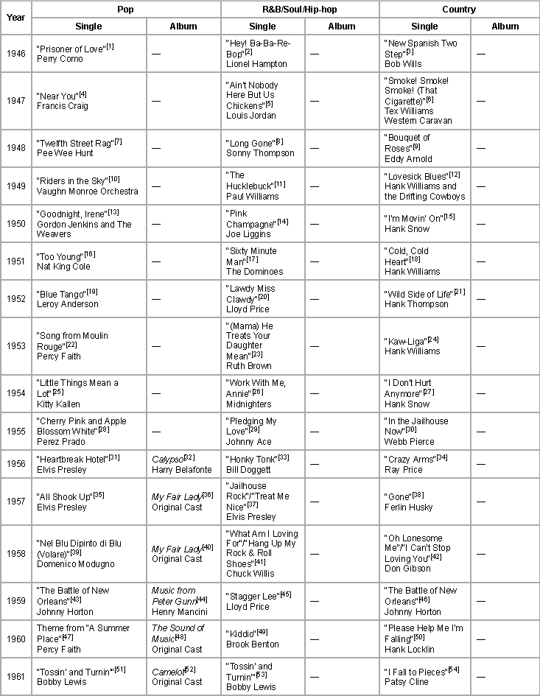




Database Data Source

Slide 5
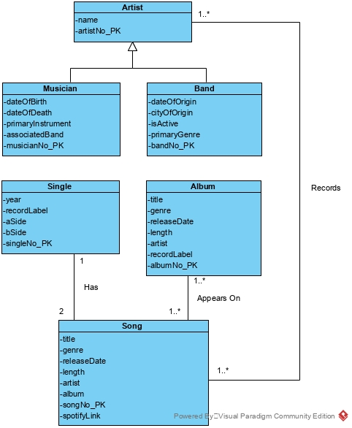
UML Diagram

Slide 6

Application Architecture
Built in Java using the Java.SQL package
Application runs on Windows
Acts as a bridge between the user and the MySQL database
Runs from the command-line
User specifies type of operation:
“create”
“read”
“update”
“delete”
Program then prompts user to input required criteria until operation can be executed

Slide 7

User Functionality
The database is capable of allowing a user to retrieve, change, remove, or add data:
Retrieving all song titles by a specified artist or produced by a specified record label
Changing a band’s active status
Adding a new single to the database by specifying its A-side and B-side song data
Removing a single from the database by specifying its A-side or B-side song title
Playing any retrieved song through Spotify integration

Slide 8
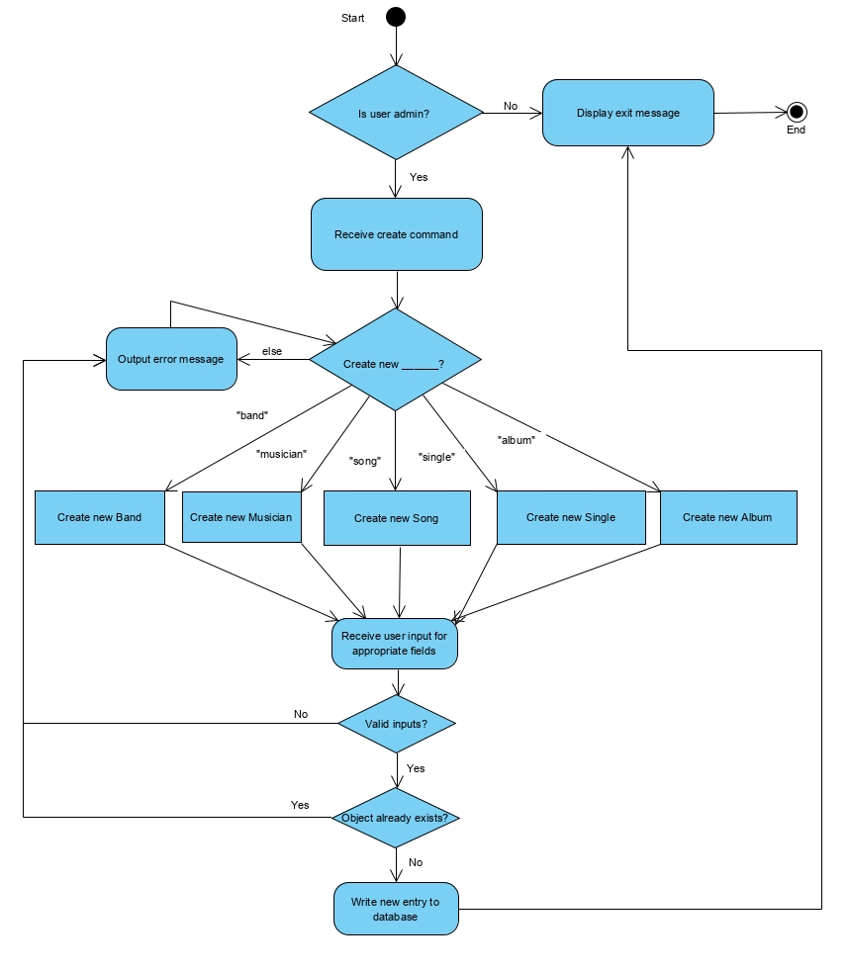
Operation Workflow: Create

Slide 9
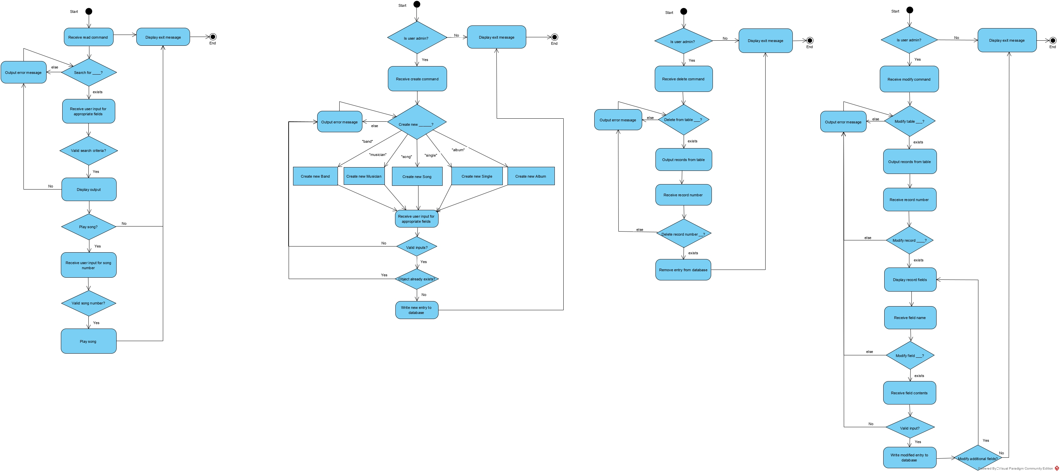
Operation Workflow: Read

Slide 10
Operation Workflow: Update

Slide 11
Operation Workflow: Delete

Slide 12
Project Relevance
Provides complex information about music to users
Allows users to expand their knowledge of music they listen to
Users are able to:
Find and play the most popular songs of the year restricted to a specific genre that interests them
Retrieve the birthday, date of death, or primary instrument of a musician that they listen to
Database provides a broad structure
Allows users to add additional data beyond the default singles charts

Slide 13
References
MySQL Logo. (n.d.). Retrieved from https://cdn.freebiesupply.com/logos/large/2x/mysql-6-logo-png-transparent.png
Spotify Logo. (n.d.). Retrieved from https://www.magneticmag.com/.image/t_share/MTY1MTczMzk2MzUzNTkwNTg0/spotify_icon_cmyk_green.png
Billboard Logo. (n.d.). Retrieved from https://www.first.edu/wp-content/uploads/2018/10/Billboard-Logo.jpg
Java Logo. (n.d.). Retrieved from https://upload.wikimedia.org/wikipedia/en/thumb/3/30/Java_programming_language_logo.svg/1200px-Java_programming_language_logo.svg.png
Concert crowd. (n.d.). Retrieved from https://cdn.freebiesupply.com/logos/large/2x/mysql-6-logo-png-transparent.png
List of Billboard Year-End number-one singles and albums. (2019, October 5). Retrieved November 21, 2019, from https://en.wikipedia.org/wiki/List_of_Billboard_Year-End_number-one_singles_and_albums.

Slide 14
Questions?

